Slide 1
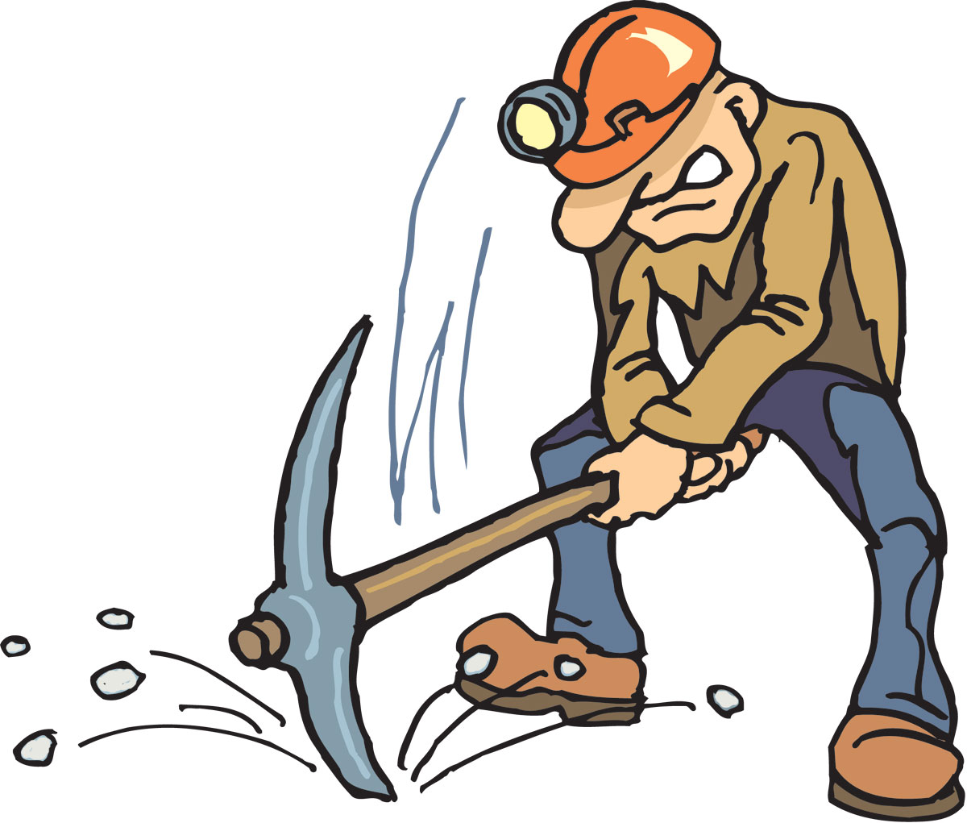



Data Mining of the Catalina Sky Survey (CSS) Archive
John Crockett and Dr. David Trilling

Slide 2
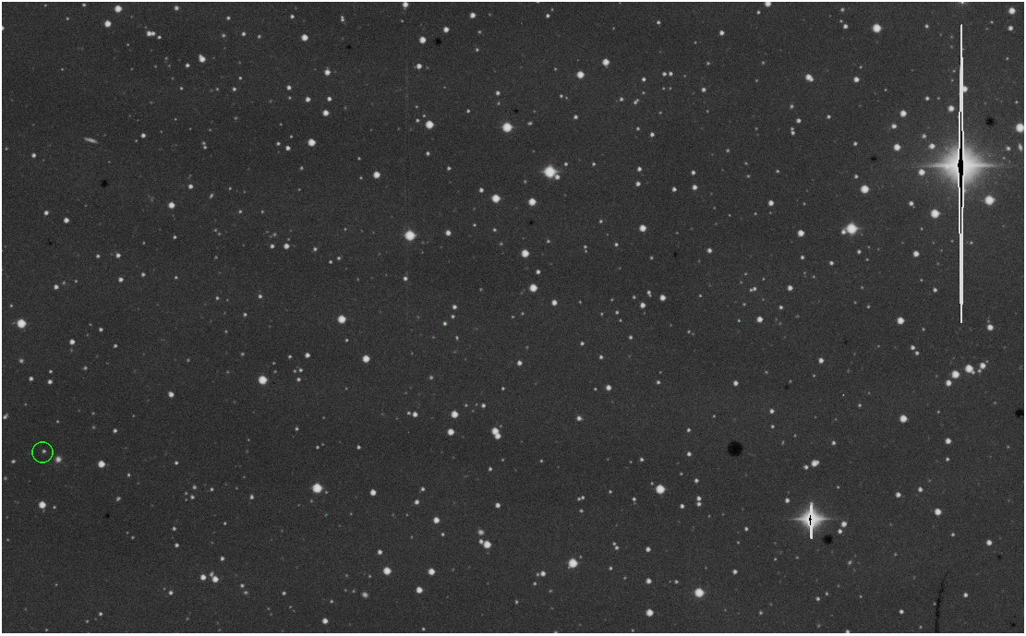

Slide 3
Project Goals
Develop a “searchable” database from CSS archive
  Astrometric/Photometric criteria
Test the utility of the database design
  “light curve” of a variable source
  Identify brown dwarf candidates
  Etcetera, etcetera, etcetera…

Slide 4
CSS Archive Details
1800 square degrees of sky each night
  Divided into 200 individual 3° x 3° “tiles”
  Includes four images of each tile (each night)
Operates every clear-weather, low-moonlit night
Over six years of archived data
Source: CSS Website - www.lpl.arizona.edu
Notes:
A square degree of sky would hold 4 moons, so this is the equivalent of the amount of sky covered by 3,200 moons

Slide 5
Project Method

Slide 6
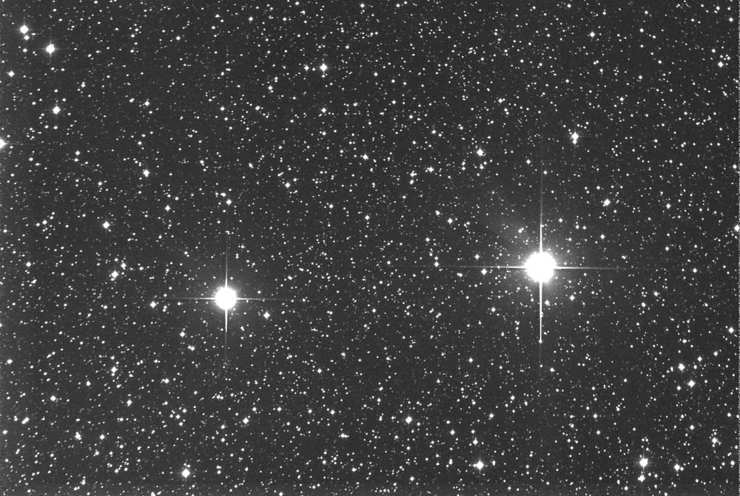

Slide 7
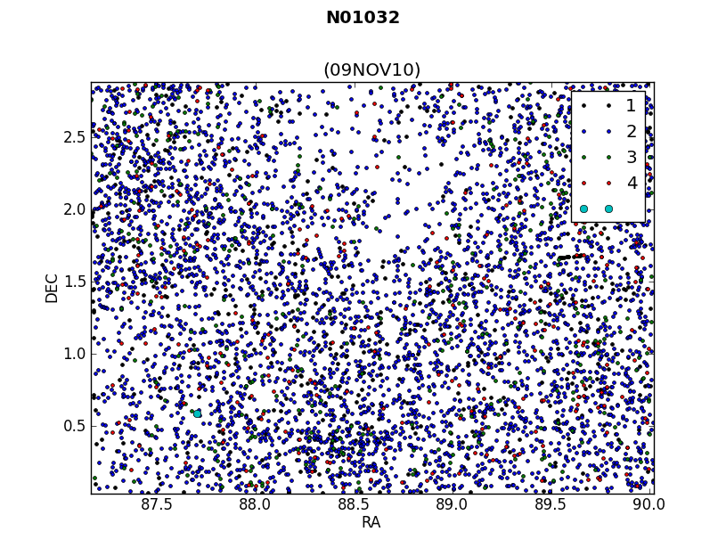

Slide 8
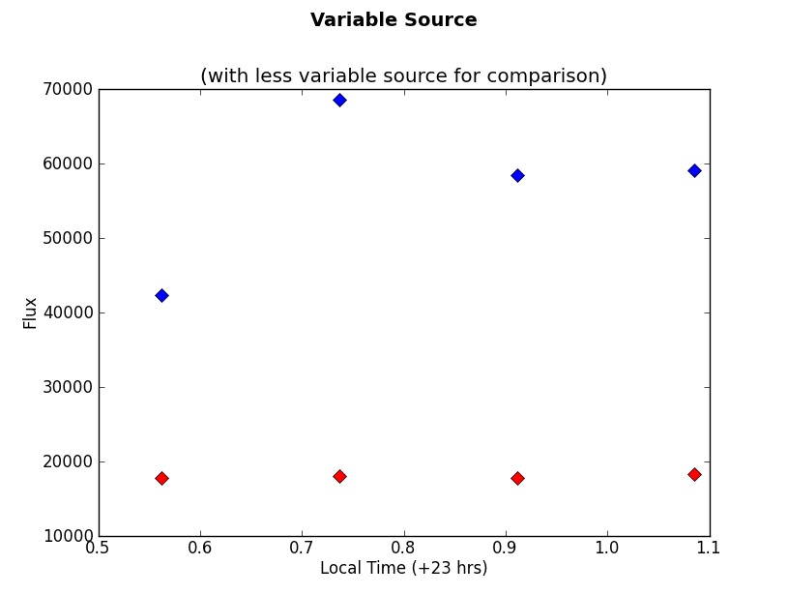

Slide 9
Conclusions
Meaningful data
“Searchability”
Candidate lists
Mitigates the need for telescope time

Slide 10
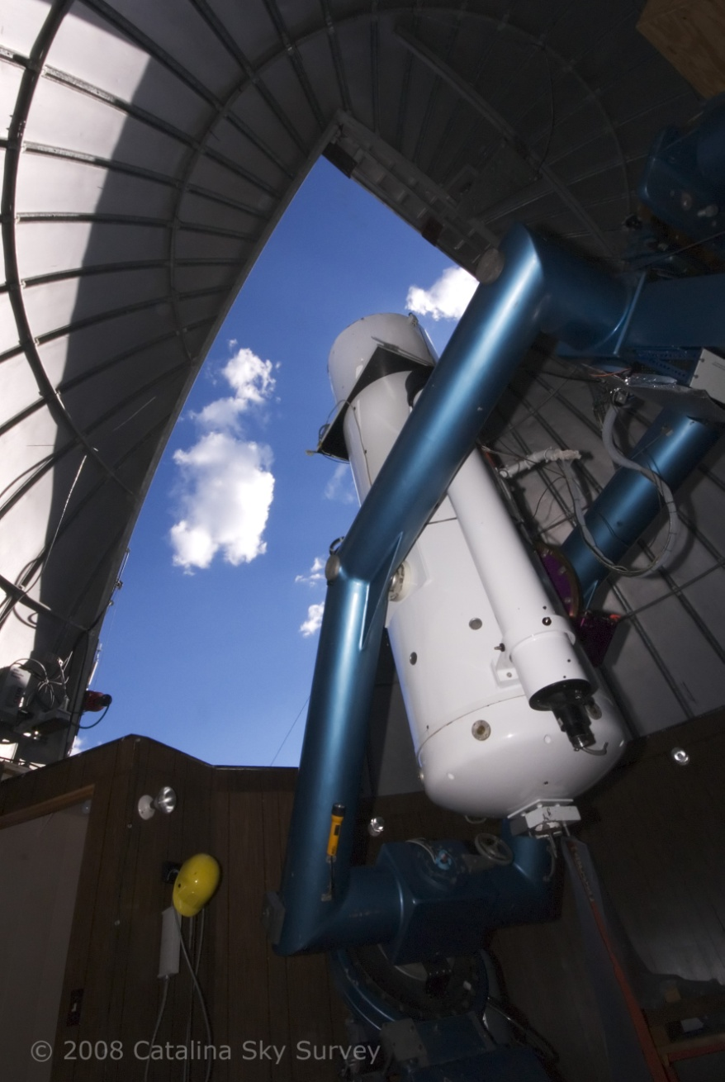
The Catalina Sky Survey
The CSS/SSS Team:
Ed Beshore (P.I.)
Steve Larson (co-I.),
Al Grauer , Andrea Boattini,
Alex Gibbs, Rik Hill,
Richard Kowalski,
At Siding Spring:
Rob McNaught,
Gordon Garradd

Slide 11
Acknowledgements
NASA Space Grant
Dr. Nadine Barlow, Ms. Kathleen Stigmon
Catalina Sky Survey Team
Dr. David Trilling

